Slide 1
ABNORMALITIES OF THE KIDNEY
PhD student Mohammed Majid Jasim

Slide 2
Urinary system:
The renal system consists of the two kidney, two ureters, urinary bladder and the urethra. The overall function of the system filters of fluid from renal blood flow which allows for toxins, metabolic waste products, and excess ion to be excreted while keeping essential substances in the blood.
Renal Blood Flow:
The kidneys are estimated to receive around 25% of an animal’s cardiac output, or roughly 4 mL/min/g of renal tissue.

Slide 4
Kidney

Slide 5
Abnormalities Of The Kidney
Developmental Anomalies
1-Renal Agenesis:
Renal agenesis is often defined as the failure of one or both kidneys to develop. Because penetration of the ureteric bud into the metanephros is the stimulation for the formation of nephrons, true renal agenesis is not associated with the presence of a ureter. If the kidney is absent but the ureter is present, the condition is termed renal dysgenesis.

Slide 6
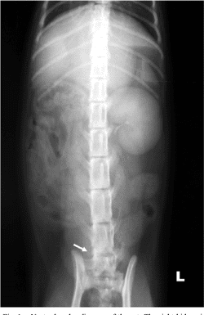
Renal agenesis is a relatively uncommon condition but has been reported in a number of different species. The right kidney is more frequently reported to be absent compared with the left.

Slide 7
2-Renal Ectopia:
The metanephros originates near the bifurcation of the aorta. As the lumbosacral region, the kidneys normally “ascend” from the pelvic region to the level of the thoracolumbar junction. Ectopic kidneys are usually found within the pelvic area, although they may be found anywhere along the normal path of ascension or even in the thorax. Ectopic kidneys should function normally and may be found during routine abdominal imaging or exploratory surgery.

Slide 8
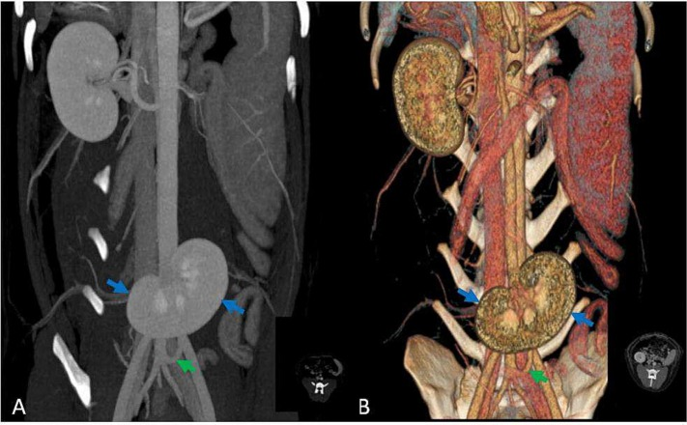

Slide 9
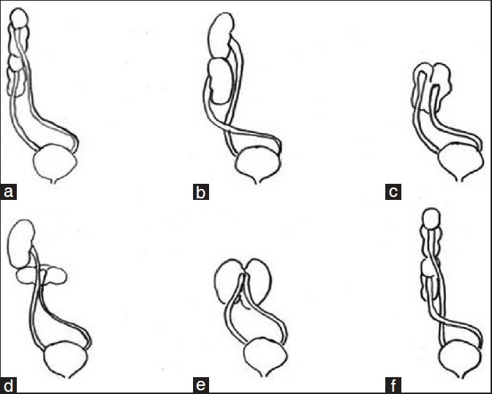
3-Fused Kidney:
A fused single kidney results from convergence of the developing kidneys as they ascend. The fused kidney is often shaped more like a horseshoe rather than the more typical bean shape. Most fused kidneys function normally.

Slide 10
Polycystic Kidney Disease:
Although rare in dogs, polycystic kidney disease is a common finding in Persian cats and breeds originating from Persian cats (exotic shorthairs, Himalayans), with an incidence estimated to be (37% - 38%) in this population. The cysts form from renal tubular cells that become separated from the originating nephron. In the end, slow progression of polycystic renal disease leads to renal failure as a result of expansion of cysts with subsequent compression of surrounding parenchyma and development of chronic interstitial lesions.
Treatment options in veterinary patients are not widely reported.

Slide 12
Renal Calculi:
Renal calculi (nephroliths or renoliths) form because of over saturation of urine with calculogenic substances. Plasma concentrations of calculogenic substances may be increased by a variety of causes such as 1-organ dysfunction (hyperammonemia secondary to liver disease or enzyme deficiency), 2-neoplasia (hypercalcemia secondary to parathyroid tumors or paraneoplastic syndrome), 3-increased calcium intake, drugs, 4-increased intestinal absorption, 5-impaired renal reabsorption. The incidence of nephroliths is increasing in dogs and cats, and the presence of renal calculi has been one of the most frequent reasons for performing renal surgery. Most calculi are composed of calcium salts (calcium oxalates, calcium phosphates)

Slide 14
Clinical Findings:
Clinical signs of nephrolithiasis may be absent or nonspecific (e.g., vomiting, lethargy, anorexia).
Other clinical findings include:
renomegaly, nonpainful hematuria, pyelonephritis, primary renal failure, and nonspecific abdominal pain (renal colic).Changes on blood work are usually mild or absent unless obstruction, pyelonephritis. Abnormalities on urinalysis may include hematuria, pyuria, or crystalluria. Urine cultures often have no growth.

Slide 15
Treatment:
Nephroliths are most commonly composed of calcium oxalate and cannot be dissolved with medical protocols. Advanced treatment should be considered if nephroliths are causing obstruction that decreases renal function; associated with severe hematuria, pain, or persistent urinary tract infection; or increasing in size and damaging renal tissue despite appropriate medical therapy.
Treatment options for stone removal include:
1-Lithotripsy.
2-Nephrotomy.
3-Pyelolithotomy.
4-Nephrectomy: should be considered in animals with a unilateral severely hydronephrotic, infected, or nonfunctional kidney.

Slide 16
Renal Neoplasia:
Types of Neoplasia:
Primary renal tumors are uncommon in dogs and cats, less than 2% of all tumors; in some reports, metastatic lesions to the kidney are more common. The majority of primary renal tumors are malignant. Lymphoma is the most common renal tumor in cats and can frequently be diagnosed with a fine-needle aspirate. Renal lymphoma can be very responsive to chemotherapy, and surgical excision may not be required. Renal cell carcinoma is the most common kidney tumor in dogs.

Slide 18
Clinical Findings:
Clinical findings in dogs with renal tumors are relatively nonspecific and may include hematuria, weight loss, lethargy, inappetence, or a palpable abdominal mass; all of these findings were reported in less than one third of affected animals. Abnormalities on urinalysis are more common, with hematuria reported in 57%, pyuria in 53%, proteinuria in 48%, and isosthenuria in 36%.
Treatment:
Because of improved imaging technique , renal neoplasms are more frequently being detected as small, asymptomatic masses. Unilateral nephrectomy is the most common treatment for affected animals unless the other kidney is diseased.

Slide 19
Acquired Renal Cysts:
Renal cysts are epithelial-lined, fluid-filled cavities. Acquired cysts can be secondary to chronic nephropathies or may be incidental findings in healthy dogs.
Clinical signs: are usually related to renal failure, with abdominal pain not always recognized. Cysts were solitary, ranging in size from 2.8 to 6.5 cm. All affected dogs had systemic hypertension, with systolic blood pressures of 160 to 190 mm Hg.
Cysts were drained percutaneously in anesthetized dogs using a spinal needle inserted under ultrasound guidance. The cyst was then infused through the same spinal needle with 95% ethanol, using a volume equivalent to half of that removed.

Slide 21
Perirenal Pseudocysts:
A perirenal pseudocyst is a unilateral or bilateral fluid accumulation around the kidney; fluid is contained within a dense membrane of fibrous connective tissue. Most commonly, the fluid is a transudate or modified transudate that collects between the renal capsule and parenchyma. Affected cats frequently have increased creatinine concentrations. The diagnosis is based on ultrasonography and analysis of aspirated fluid. Perirenal pseudocysts are reported sporadically in cats and, although they have been linked with chronic renal disease (glomerulonephritis and interstitial nephritis), the mechanism of fluid accumulation is unknown.
Surgical resection of the pseudocyst without nephrectomy did not prevent progression of renal disease.

Slide 23
Renal Abscesses:
Renal abscesses are rare in dogs and have been reported in association with pyelonephritis, nephrolithiasis, renal biopsy, and hyperadrenocorticism. An abscess may develop within renal parenchyma or surrounding the kidney (perinephric abscessation). The diagnosis is made on ultrasonography with confirmation of the abscess based on fluid cytology and culture.
Treatment:
Includes supportive care and nephrectomy.

Slide 24
Renal Trauma:
Reports of renal trauma are extremely rare in the veterinary. In one study, renal trauma was the cause of primary renal failure in only 2.7% of 486 dogs. The kidney, or its blood supply, can be injured by blunt trauma, such as vehicular accidents, or by sharp penetration, animal bites, or other implements. Trauma can result in capsular tears, parenchymal fractures, perirenal or renal hematomas, crush injuries, vascular avulsion, or renal prolapse. Renal or renal vascular trauma is usually suspected based on clinical findings of anemia, with or without renal azotemia, and retroperitoneal hemorrhage detected by ultrasonography and verified with ultrasound-guided aspirates. Definitive diagnosis may require contrast angiography or exploratory laparotomy.

